Slide 1
Red-black trees

Slide 2
Outline
In this topic, we will cover:
The idea behind a red-black tree
Defining balance
Insertions and deletions
The benefits of red-black trees over AVL trees

Slide 3
Balanced search trees
Balanced search tree: A search-tree data structure for which a height of O(lg n) is guaranteed when implementing a dynamic set of n items.
Examples:
AVL trees
Red-black trees
2-3 trees
2-3-4 trees
B-trees/B⁺-trees
October 19, 2005
Copyright © 2001-5 by Erik D. Demaine and Charles E. Leiserson
L7.2

Slide 4
Red-black trees
This data structure requires an extra one-bit color field in each node.
Red-black properties:
Every node is either red or black.
The root and leaves (NIL’s) are black.
If a node is red, then its parent is black.
All simple paths from any node x to a descendant leaf have the same number of black nodes = black-height(x).
October 19, 2005
Copyright © 2001-5 by Erik D. Demaine and Charles E. Leiserson
L7.3

Slide 5
Red Black Trees
A BST with more complex algorithms to ensure balance
Each node is labeled as Red or Black.
Path: A unique series of links (edges) traverses from the root to each node.
The number of edges (links) that must be followed is the path length
In Red Black trees paths from the root to elements with 0 or 1 child are of particular interest

Slide 6
Red-Black Trees
A red black tree “colours” each node within a tree either red or black
This can be represented by a single bit
In AVL trees, balancing restricts the difference in heights to at most one
For red-black trees, we have a different set of rules related to the colours of the nodes

Slide 7
Red-Black Trees
The three rules which define a red-black tree are
1. The root must be black,
2. If a node is red, its children must be black, and
3. Each null path must have the same number of black nodes

Slide 8
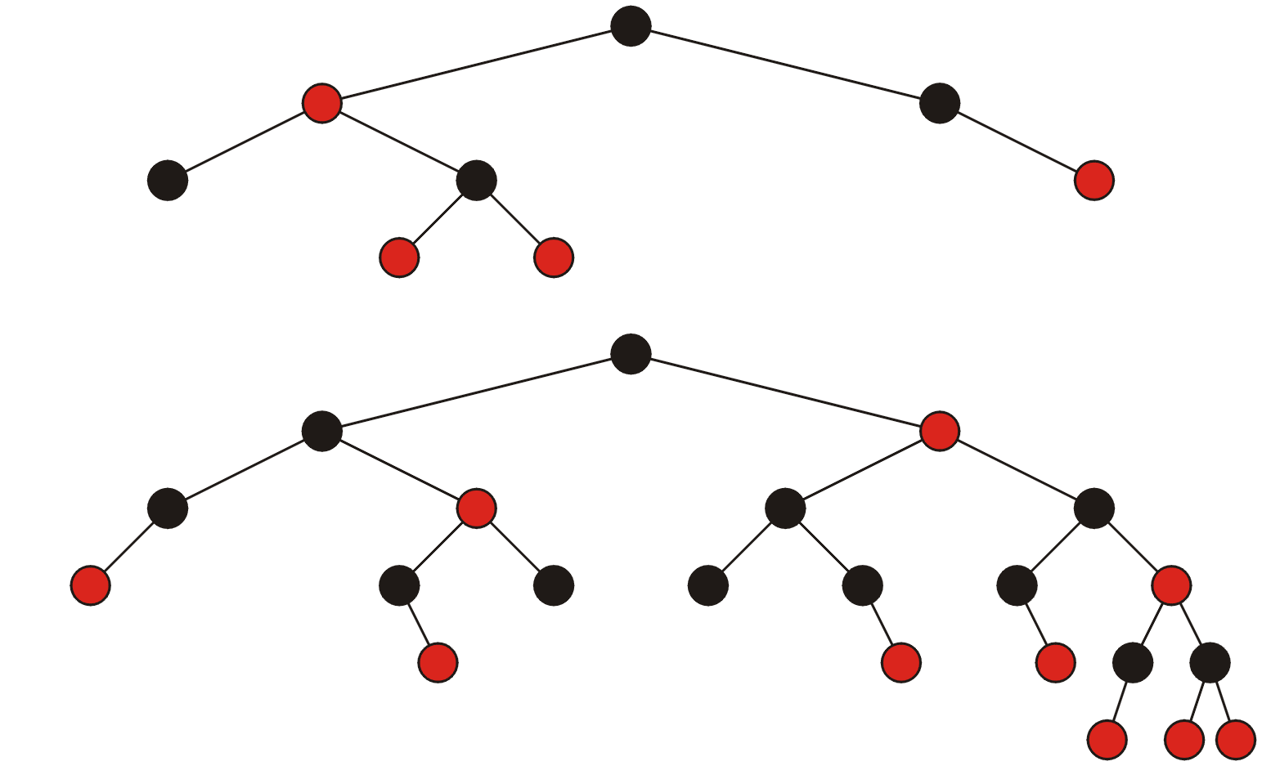
Red-Black Trees
These are two examples of red-black trees:

Slide 9
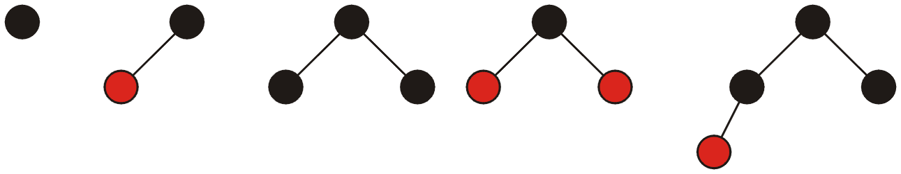
Red-Black Trees
All red-black trees with 1, 2, 3, and 4 nodes:

Slide 10
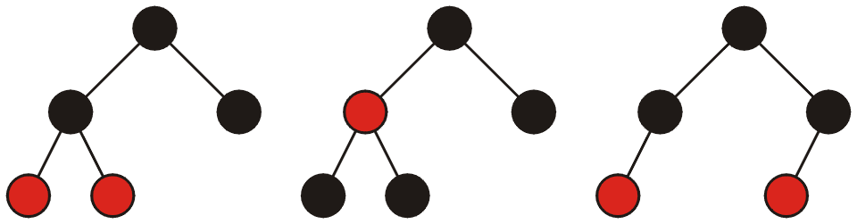
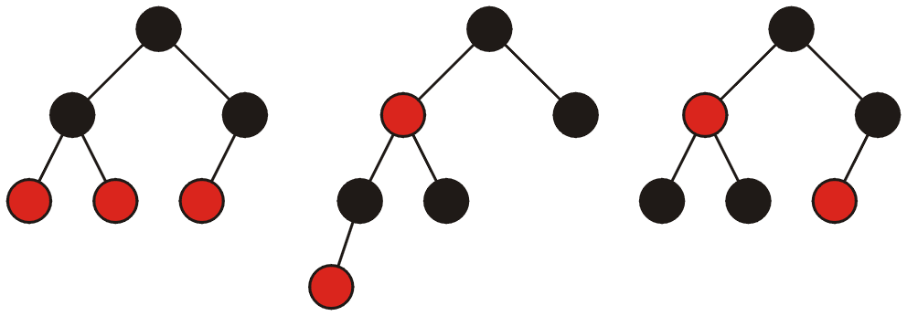
Red-Black Trees
All red-black trees with 5 and 6 nodes:

Slide 11
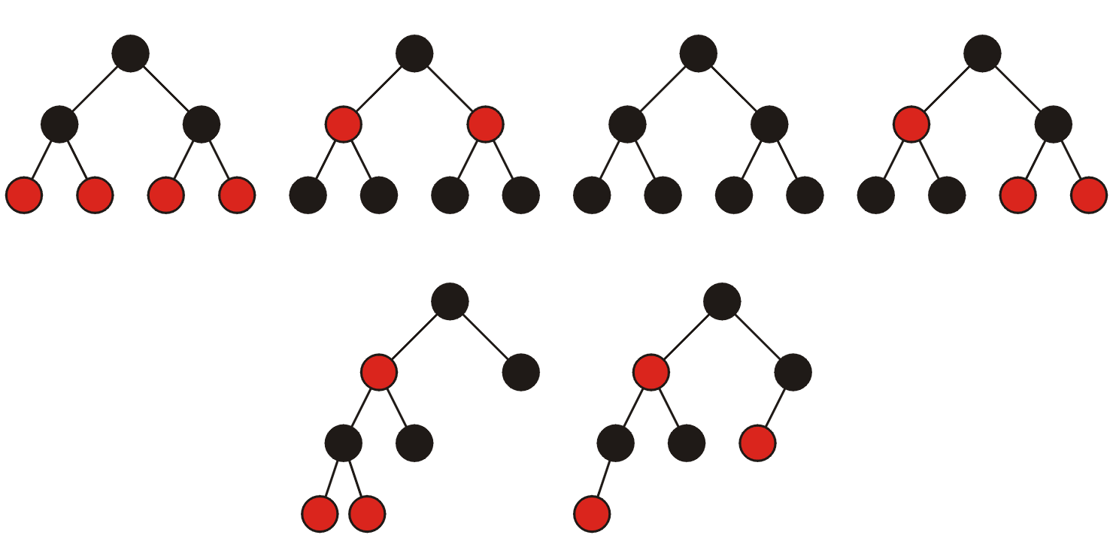
Red-Black Trees
All red-black trees with seven nodes—most are shallow:

Slide 12
Red-Black Trees
A little manipulation shows that the worst-case height simplifies to
h_{worst} = 2 lg(n + 2) – 3
This grows quicker than the worst-case height for an AVL tree
h_{worst} = log_{φ}( n ) – 1.3277

Slide 13
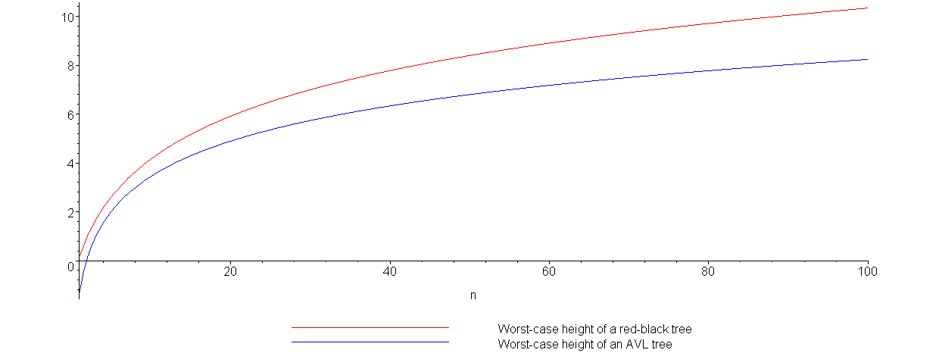
Red-Black Trees
Plotting the growth of the height of the worst-case red-black tree (red) versus the worst-case AVL tree (blue) demonstrates this:

Slide 14
Red-Black Trees
Height | AVL Tree | Red-Black Tree
1 | 2 | 2
3 | 7 | 6
5 | 20 | 14
7 | 54 | 30
9 | 143 | 62
11 | 376 | 126
13 | 986 | 254
15 | 2583 | 510
17 | 6764 | 1022
19 | 17710 | 2046
21 | 46367 | 4094
23 | 121492 | 8190
25 | 317810 | 16382
27 | 832039 | 32766
29 | 2178308 | 65534
31 | 5702886 | 131070
33 | 14930351 | 262142
This table shows the number of nodes in a worst-case trees for the given heights
Thus, an AVL tree with 131070 nodes has a height of 23 while a red-black tree could have a height as large as 31

Slide 15
Red-Black Trees
Comparing red-black trees with AVL trees, we note that:
Red-black trees require one extra bit per node
AVL trees require one byte per node (assuming the height will never exceed 255)
aside: we can reduce this to two bits, storing one of –1, 0, or 1 indicating that the node is left heavy, balanced, or right heavy, respectively

Slide 16
Red Black Trees Insertion
Step 1 - If tree is Empty then insert the newNode as Root node with color Black and exit from the operation.
Step 2 - If tree is not Empty then insert the newNode as leaf node with color Red.
Step 3 - If the parent of newNode is Black then exit from the operation.
Step 4 - If the parent of newNode is Red then check the color of parentnode's sibling of newNode (Uncle’s newNode).
Step 4.a - If it is colored Black or NULL then make suitable rotation and recolor.
Step 4.b - If it is colored Red then perform recolor and also check if parent’s parent of newNode (grandparent’s newNode) is not root node then recolor it and recheck (repeat the same until tree becomes Red Black Tree.)

Slide 17
We have 3 cases for insertion
Case 1: Recolor (uncle is red)
G
G
P
U
P
U

Slide 18
Case 2:
Double Rotate: X around P then X around G.
Recolor G and X
G
X
P
P
U
G
X
S
U
S

Slide 19
Case 3:
Single Rotate P around G
Recolor P and G
G
P
P
U
X
G
S
X
S
U

Slide 20
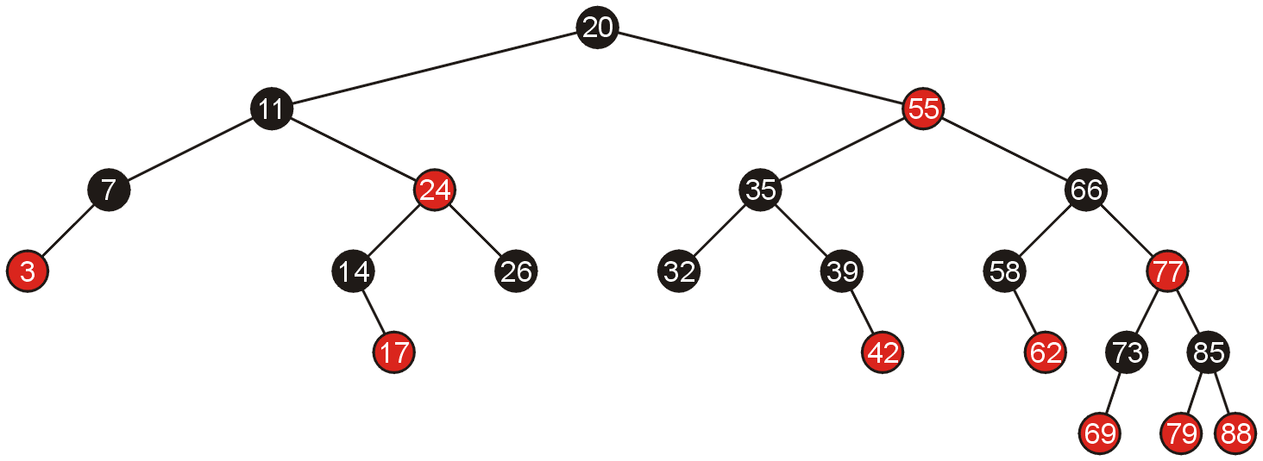
Examples of Insertions
Given the following red-black tree, we will make a number of insertions

Slide 21
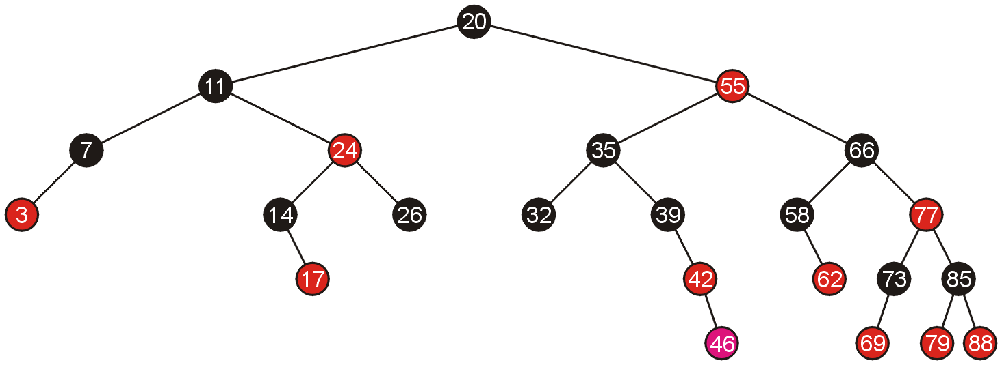
Examples of Insertions
Adding 46 creates a red-red pair which can be corrected with a single rotation

Slide 22
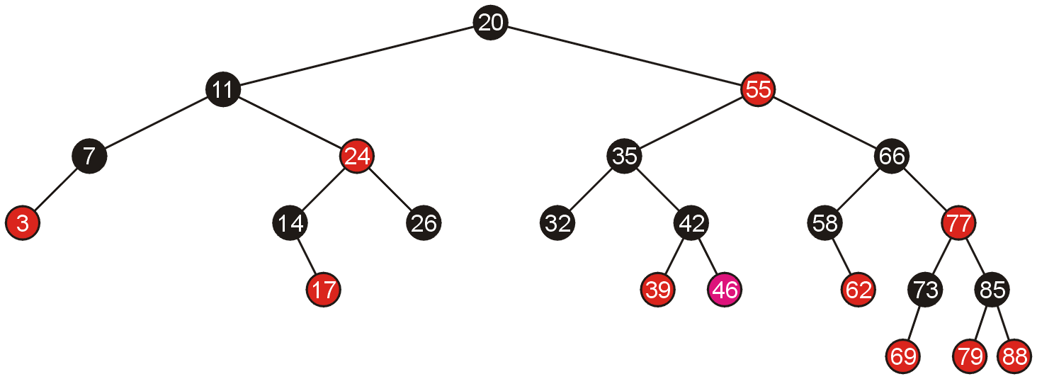
Examples of Insertions
Because the pivot is still black, we are finished

Slide 23
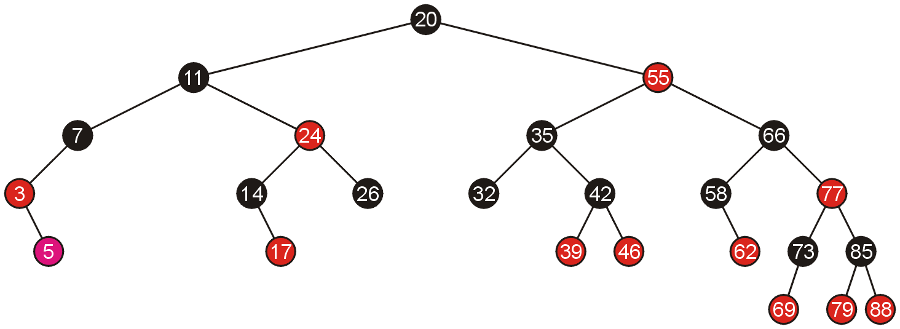
Examples of Insertions
Similarly, adding 5 requires a single rotation

Slide 24
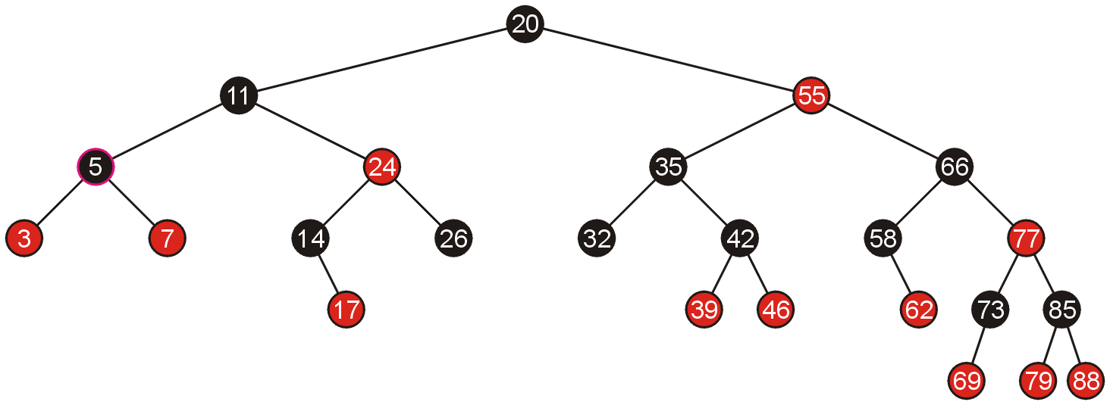
Examples of Insertions
Which again, does not require any additional work

Slide 25
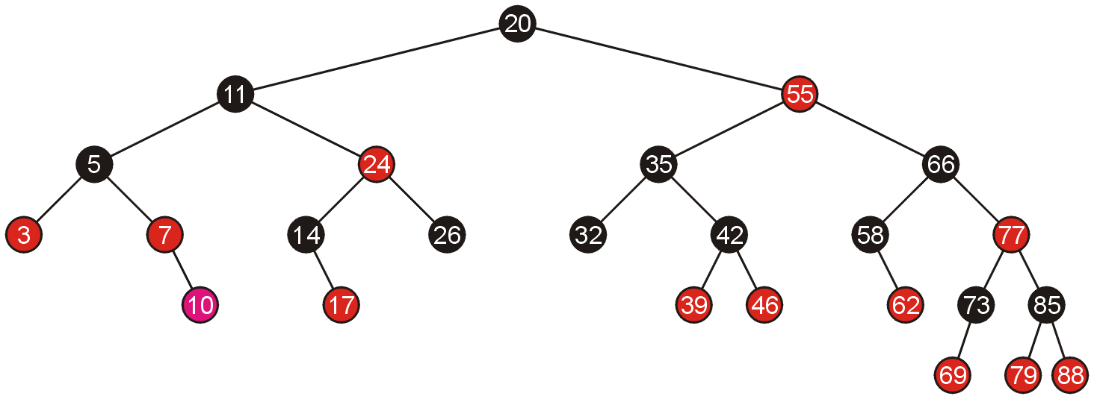
Examples of Insertions
Adding 10 allows us to simply swap the colour of the grand parent and the parent and the parent’s sibling

Slide 26
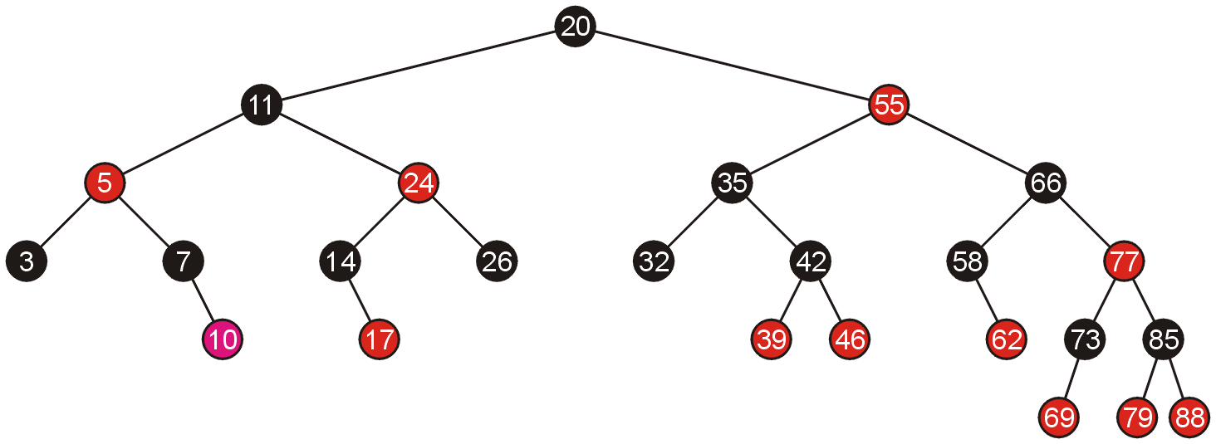
Examples of Insertions
Because the parent of 5 is black, we are finished

Slide 27
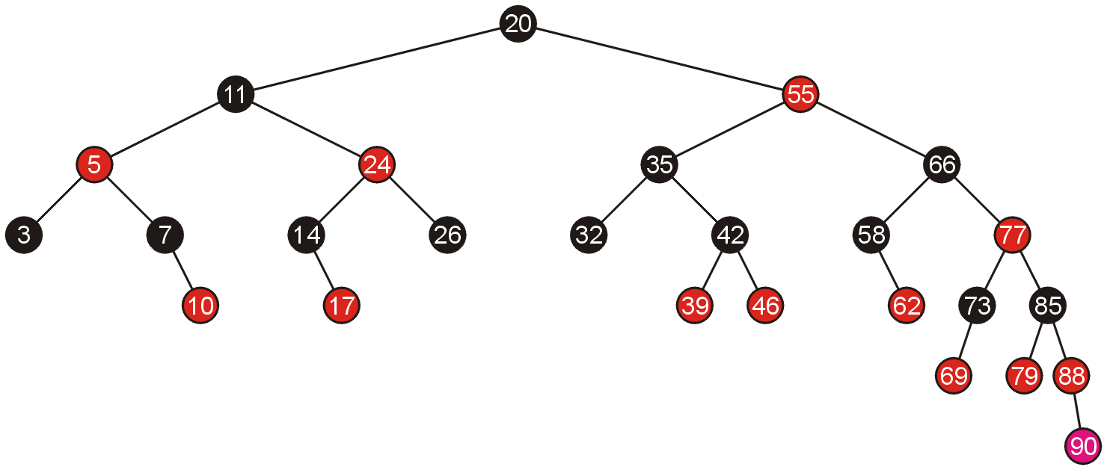
Examples of Insertions
Adding 90 again requires us to swap the colours of the grandparent and its two children

Slide 28
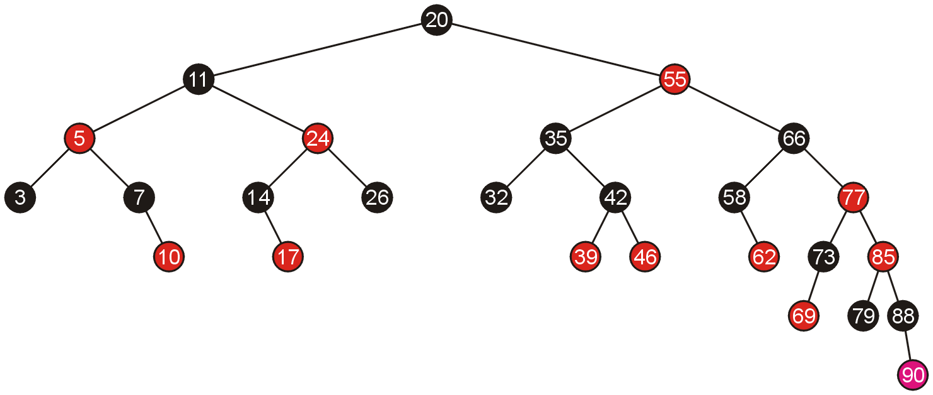
Examples of Insertions
This causes a red-red parent-child pair, which now requires a rotation

Slide 29
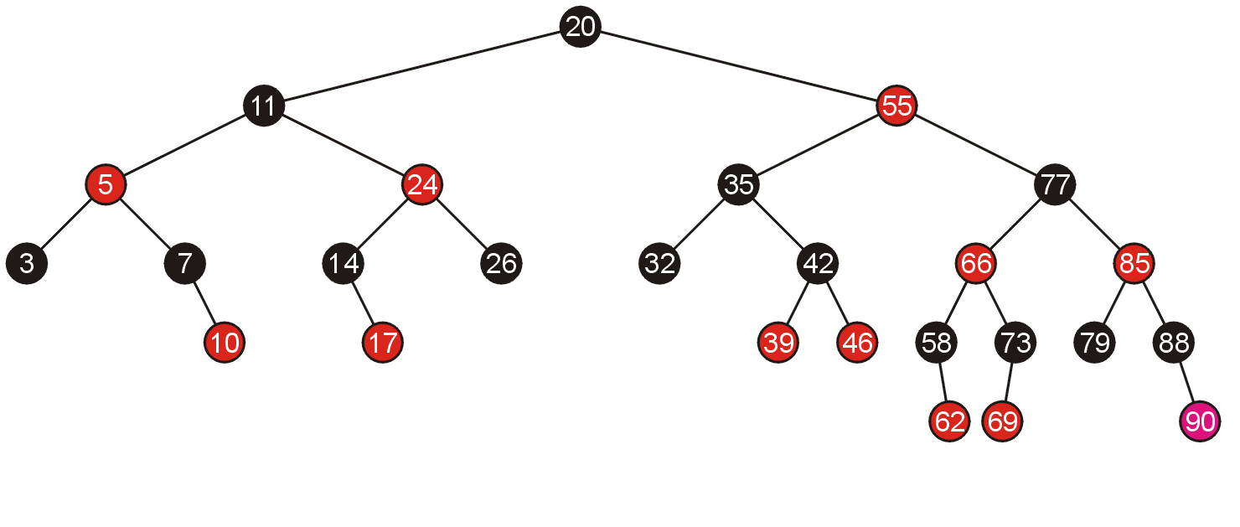
Examples of Insertions
A rotation does not require any subsequent modifications, so we are finished

Slide 30
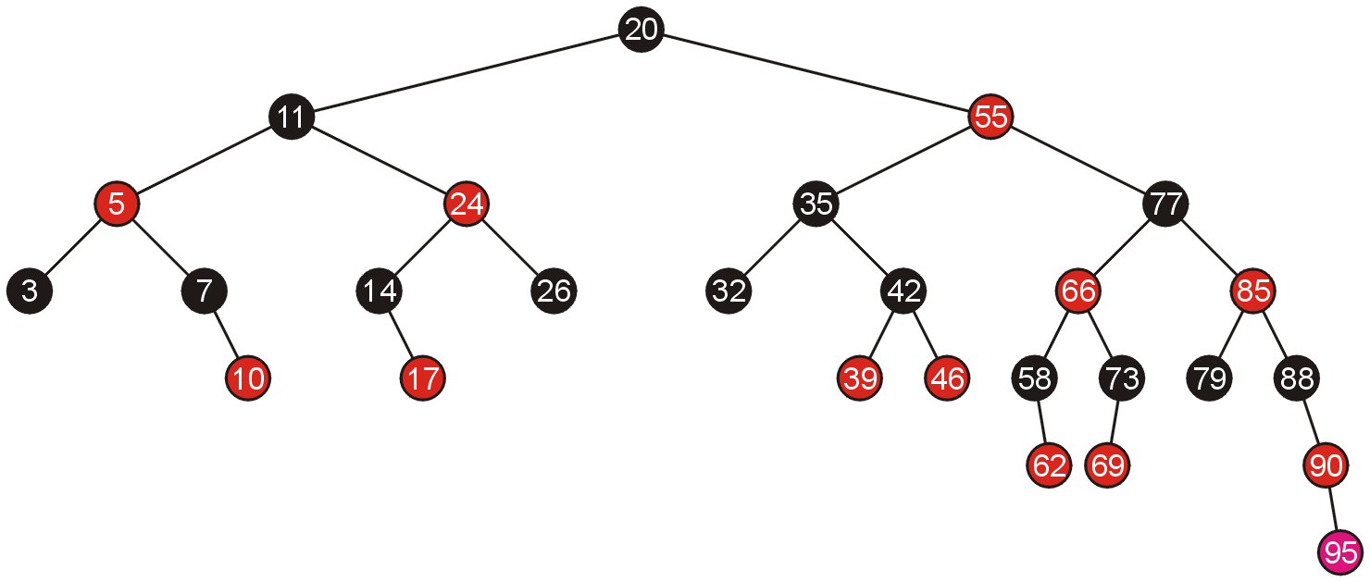
Examples of Insertions
Inserting 95 requires a single rotation

Slide 31
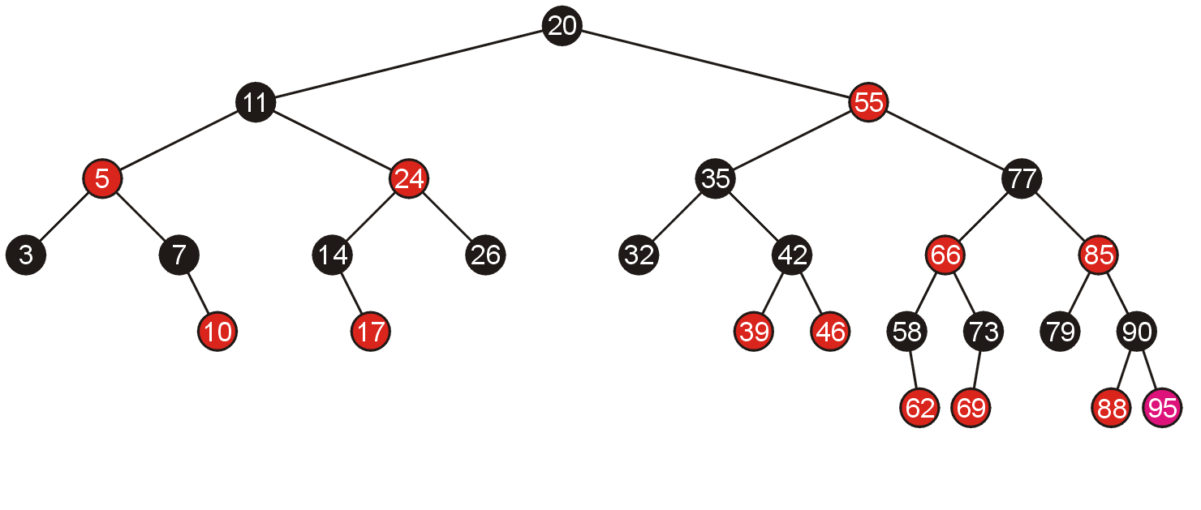
Examples of Insertions
And consequently, we are finished

Slide 32
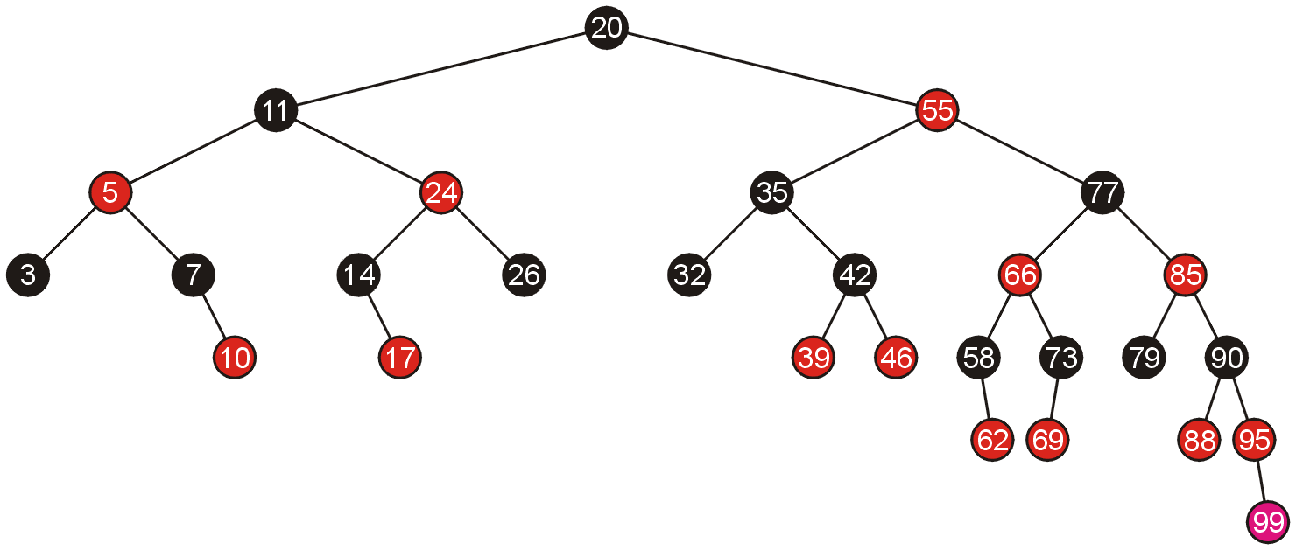
Examples of Insertions
Adding 99 requires us to swap the colours of its grandparent and the grandparent’s children

Slide 33
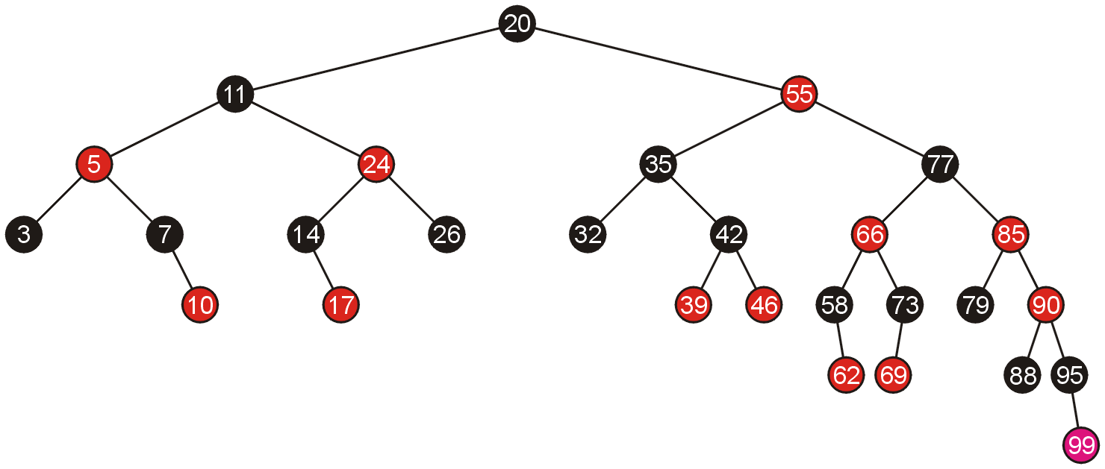
Examples of Insertions
This causes another red-red child-parent conflict between 85 and 90 which must be fixed, again by swapping colours

Slide 34
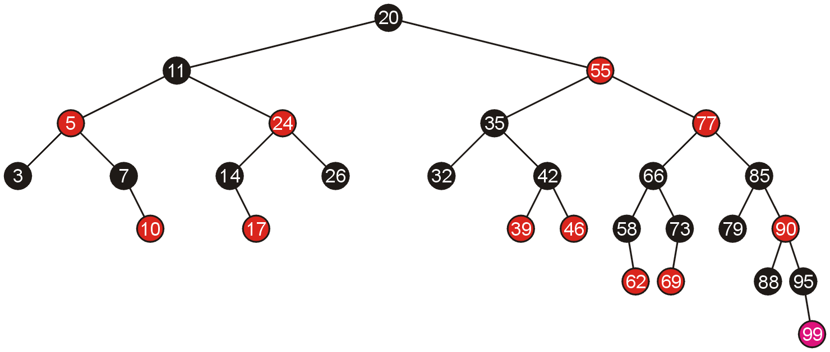
Examples of Insertions
This results in another red-red parent-child conflict, this time, requiring a rotation

Slide 35
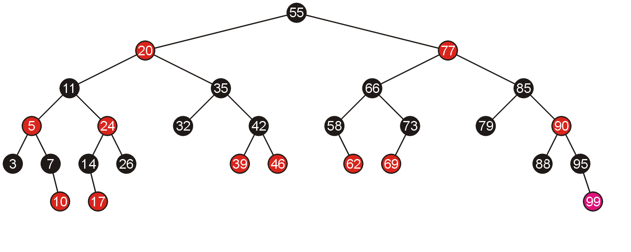
Examples of Insertions
Thus, the rotation solves the problem

Slide 36
Example 2
Create a red-black tree by inserting the following sequence of numbers 8, 18, 5, 15, 17, 25, 40, and 80
Notes:
http://www.btechsmartclass.com/data_structures/red-black-trees.html

Slide 37
Pseudocode
RB-INSERT(T, x) TREE-INSERT(T, x)
color[x] ← RED ⊳ only RB property 3 can be violated
while x ≠ root[T] and color[p[x]] = RED
do if p[x] = left[p[p[x]]
then y ← right[p[p[x]]
if color[y] = RED
then ⟨Case 1⟩
else if x = right[p[x]]
then ⟨Case 2⟩
⊳ y = aunt/uncle of x
⊳ Case 2 falls into Case 3
⟨Case 3⟩
else ⟨“then” clause with “left” and “right” swapped⟩
color[root[T]] ← BLACK
October 19, 2005
Copyright © 2001-5 by Erik D. Demaine and Charles E. Leiserson
L7.24

Slide 38
Graphical notation
Let denote a subtree with a black root.
All ’s have the same black-height.
October 19, 2005
Copyright © 2001-5 by Erik D. Demaine and Charles E. Leiserson
L7.25

Slide 39
Case 1
Recolor
C
C
new x
D
C
C
A
x
y
D
A
B
B
(Or, children of A are swapped.)
Push C’s black onto A and D, and recurse, since C’s parent may be red.
October 19, 2005
Copyright © 2001-5 by Erik D. Demaine and Charles E. Leiserson
L7.26

Slide 40

Case 2
LEFT-ROTATE(A)
C
C_{C}
y
y
A
x
B_{B}
B
x
A_{A}
Transform to Case 3.
October 19, 2005
Copyright © 2001-5 by Erik D. Demaine and Charles E. Leiserson
L7.27

Slide 41
Case 3
RIGHT-ROTATE(C)
y
A_{A}
C
B
B
C
x
A
Done! No more violations of RB property 3 are possible.
October 19, 2005
Copyright © 2001-5 by Erik D. Demaine and Charles E. Leiserson
L7.28

Slide 42
Analysis
Go up the tree performing Case 1, which only recolors nodes.
If Case 2 or Case 3 occurs, perform 1 or 2 rotations, and terminate.
Running time: O(lg n) with O(1) rotations.
RB-DELETE — same asymptotic running time and number of rotations as RB-INSERT.
October 19, 2005
Copyright © 2001-5 by Erik D. Demaine and Charles E. Leiserson
L7.29

Slide 43
Example of Inserting Sorted Numbers
1 2 3 4 5 6 7 8 9 10
Insert 1. A leaf so red. Realize it is root so recolor to black.
1
1

Slide 44
Insert 2
make 2 red. Parent is black so done.
1
2

Slide 45
Insert 3
1
Insert 3. Parent is red. Parent's sibling is black (null) 3 is outside relative to grandparent. Rotate parent and grandparent
2
3
2
1
3

Slide 46
Insert 4
On way down see 2 with 2 red children. Recolor 2 red and children black. Realize 2 is root so color back to black
2
1
3
2
When adding 4 parent is black so done.
1
3
4

Slide 47
Insert 5
2
1
3
4
5's parent is red. Parent's sibling is black (null). 5 is outside relative to grandparent (3) so rotate parent and grandparent then recolor
5

Slide 48
Finish insert of 5
2
1
4
3
5

Slide 49
Insert 6
2
1
4
On way down see 4 with 2 red children. Make 4 red and children black. 4's parent is black so no problem.
3
5

Slide 50
Finishing insert of 6
6's parent is black so done.
2
1
4
3
5
6

Slide 51
Insert 7
2
1
4
3
5
7's parent is red. Parent's sibling is black (null). 7 is outside relative to grandparent (5) so rotate parent and grandparent then recolor
6
7

Slide 52
Finish insert of 7
2
1
4
3
6
5
7

Slide 53
Insert 8
2
1
4
3
6
On way down see 6 with 2 red children. Make 6 red and children black. This creates a problem because 6’s parent, 4, is also red. Must perform rotation.
5
7

Slide 54
Still Inserting 8
2
Recolored now need to rotate
1
4
3
6
5
7

Slide 55
Finish inserting 8
4
Recolored now need to rotate
2
6
1
3
5
7
8

Slide 56
Insert 9
4
2
6
1
3
5
7
8
On way down see 4 has two red children so recolor 4 red and children black. Realize 4 is the root so recolor black
9

Slide 57
Finish Inserting 9
4
2
6
1
3
5
8
7
9
After rotations and recoloring

Slide 58
Insert 10
4
2
6
1
3
5
8
7
9
On way down see 8 has two red children so change 8 to red and children black
10

Slide 59
Insert 11
4
2
6
1
3
5
8
7
9
10
Again a rotation is needed.
11

Slide 60
Finish inserting 11
4
2
6
1
3
5
8
7
10
9
11

Slide 61
Analysis of Insertion
A red-black tree has O(log n) height
Search for insertion location takes O(log n) time because we visit O(log n) nodes
Addition to the node takes O(1) time
Rotation or recoloring takes O(log n) time because we perform
* O(log n) recoloring, each taking O(1) time, and
* at most one rotation taking O(1) time
- Thus, an insertion in a red-black tree takes O(log n) time

Slide 62
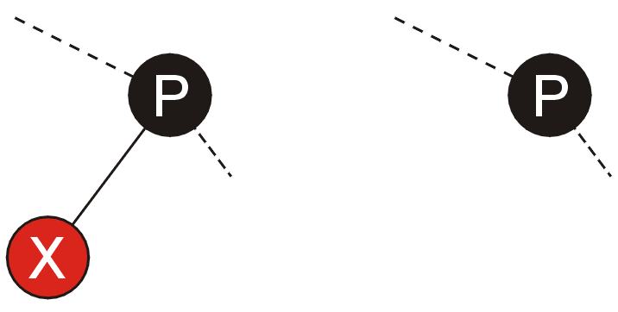
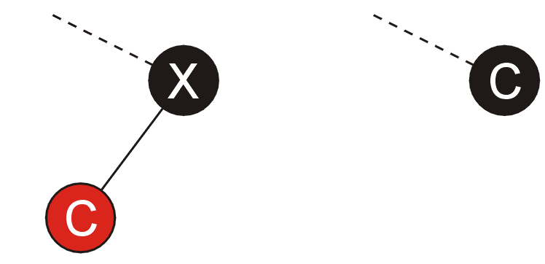
Top-Down Deletions
If we are deleting a red leaf node X, then we are finished
If we are deleting a node X with one child, we only need to replace the value of the deleted node with the value of the leaf node

Slide 63
Top-Down Deletions
If we are deleting a full node, we use the same strategy used in standard binary search trees:
replace the node with the minimum element in the right sub-tree
then delete that element from the right sub-tree

Slide 64
Top-Down Deletions
That minimum element must be either:
a red leaf node,
a black node with a single red leaf node, or
a black leaf node
The first two cases are solved, consequently, we need only deal with the possibility that the leaf node we are deleting is black

Slide 65
Top-Down Deletions
Similar to top-down insertions, we will adopt a strategy which ensures that the leaf node being deleted is not black

Slide 66
Red-Black Trees
In this topic, we have covered red-black trees
simple rules govern how nodes must be distributed based on giving each node a colour of either red or black
insertions and deletions may be performed without recursing back to the root
only one bit is required for the “colour”
this makes them, under some circumstances, more suited than AVL trees

